Slide 1
MIniEcoset
By: Ritika Jeloka

Slide 2


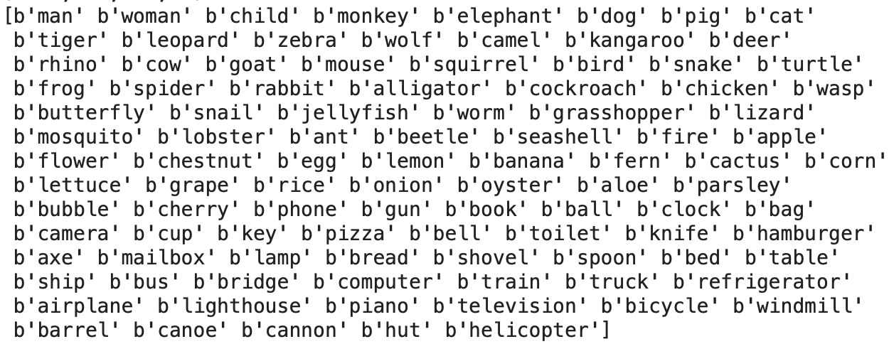
DATASET DETAILS
20 classes each:
natural-animate-mammals (e.g. human, cats)
natural-animate-rest (e.g. reptiles, fish)
natural-inanimate (e.g. plants, frutis)
artificial-small (e.g. camera, pizza)
artificial-large (e.g. bicycle, piano)
Notes:
Traun set 2350, Test set 50 images, load pretrained resnet50, remove last layer and change to output of 100 classes, remove last connected layer to get outputs; pass testset through moel to get acrivations, pca o remove dimensionality,
Batch Training: The data is divided into batches, and each batch is used to compute the gradient of the loss function. This batch training helps improve training efficiency and allows models to generalize better.
Shuffling: During each epoch, the training data is shuffled using shuffle=True when creating the train_loader. Shuffling ensures that the model does not see the data in a fixed order during training, reducing the risk of the model learning sequence-dependent patterns.
Loss Function: It uses the cross-entropy loss (torch.nn.CrossEntropyLoss()) as the loss function. Cross-entropy loss is commonly used for classification tasks and measures the dissimilarity between predicted class probabilities and true class labels.
Optimization Algorithm: The code uses the Adam optimizer (optim.Adam()) to update the model's parameters. Adam is an adaptive optimization algorithm that adjusts the learning rate during training to speed up convergence.
Training and Evaluation Phases:
The code switches between training and evaluation phases using model.train() and model.eval(). In the training phase, the model's parameters are updated based on the gradients of the loss. In the evaluation phase, no gradients are computed, and the model is used to make predictions on the validation data.
GPU Usage: The code checks for the availability of a GPU (torch.cuda.is_available()) and moves the model to the GPU if it's available. Training on a GPU can significantly speed up training for deep learning models.
Epochs: Training occurs over multiple epochs (in this case, 10 epochs). An epoch represents one pass through the entire training dataset. Training for multiple epochs allows the model to learn from the data iteratively and refine its parameters.
Accuracy Calculation: After each epoch, the code calculates and prints the training loss and validation loss. It also calculates the accuracy on the validation dataset to assess the model's performance.
Early Stopping: While early stopping is not explicitly implemented in this code, it is a common technique to prevent overfitting. You can monitor the validation loss and stop training when it starts increasing or plateaus.

Slide 3
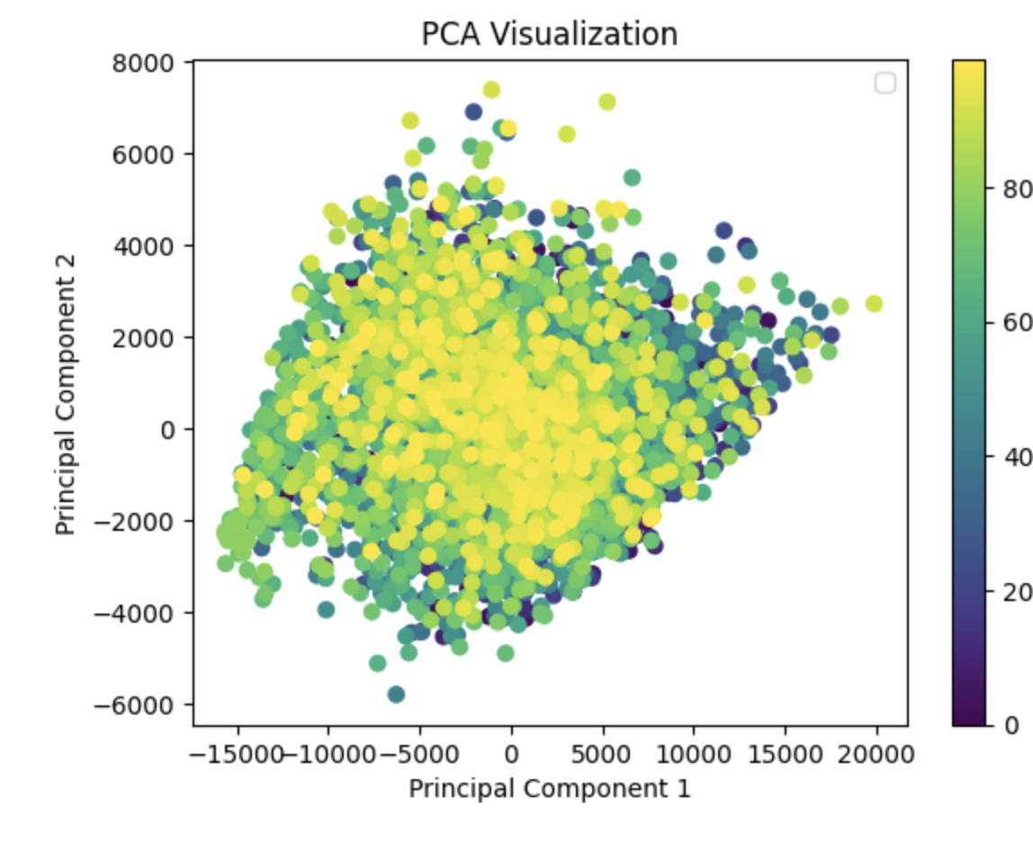
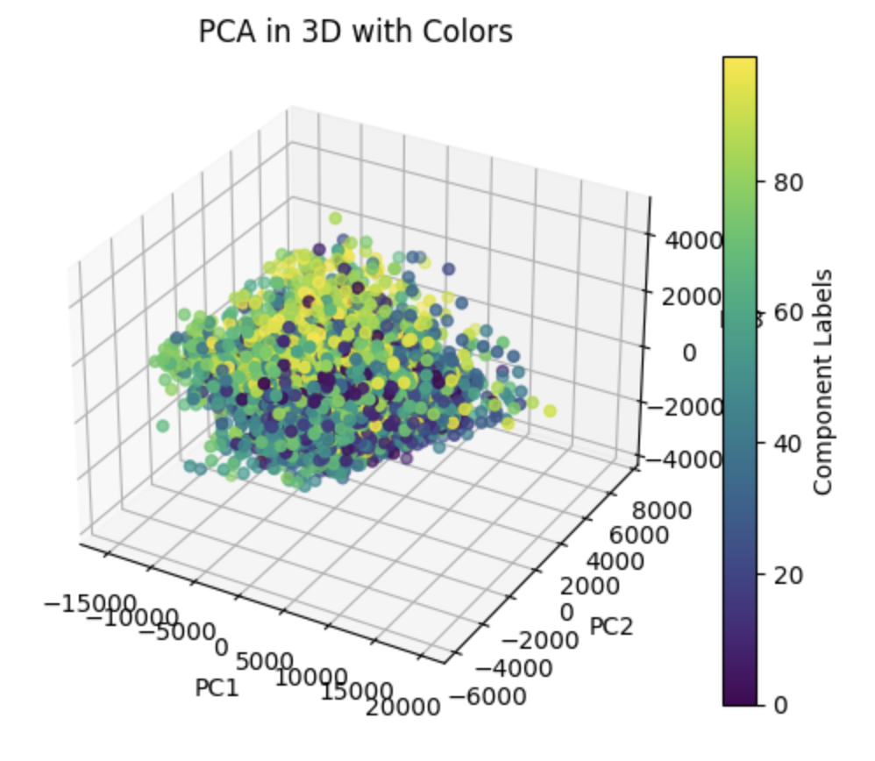
PCA
Notes:
Cross entropy loss good for classification. maximum likelihood estimation (MLE) using probabailities
ResNet-50 consists of 50 convolutional layers, including residual blocks, along with pooling layers, fully connected layers, and an output layer. The network architecture is designed to extract hierarchical features from input images, making it well-suited for image classification and related tasks.

Slide 4
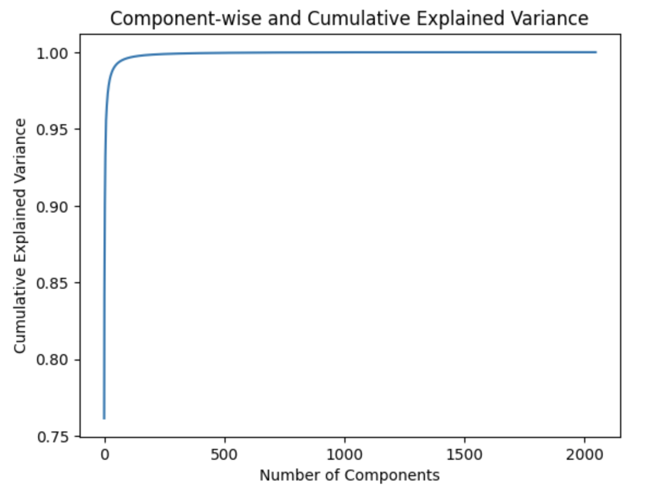
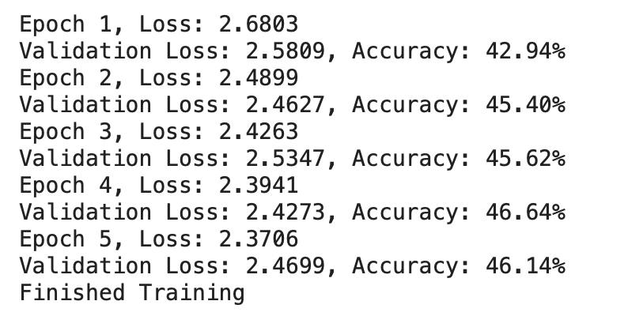
100 components, EPOCHS = 4
Notes:
Look for outliers in data, use another dimensionality reduction technique, smaller # of components, other quantitative metrics

